Slide 1
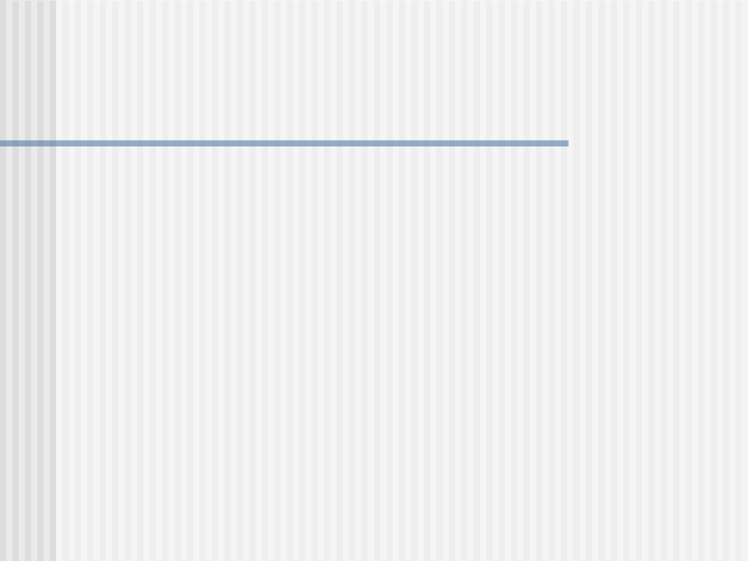
Introduction to Interaction Diagrams
  Used to illustrate the dynamic behaviour of a community of objects that collaborate by passing messages in order to perform a certain task.
  Use cases list the behaviour
  Interaction diagrams can designate the way objects collaborate to implement the behaviour.
  As an example, consider the successful scenario of the "Withdraw Cash" use case.

Slide 2
Introduction to Interaction Diagrams
  Class diagram will describe the static structure of the system-under-design.
  Lists classes like Customer, Atm and Server and depict the association between them.
  Properties of the above classes listed as attributes
  Operations provided in each class in order to manipulate the values of the attributes as well as to perform computations.

Slide 3
Introduction to Interaction Diagrams
  Interaction diagrams are used to show the manner in which messages are passed between objects as the system executes to implement a specific behaviour.
  In the above example, upon insertion of the card by the customer, which object should send a message to whom and upon execution of that object's operation what should happen next is indicated by interaction diagrams.
  The two types of interaction diagrams discussed below are sequence and Communication diagrams.

Slide 4
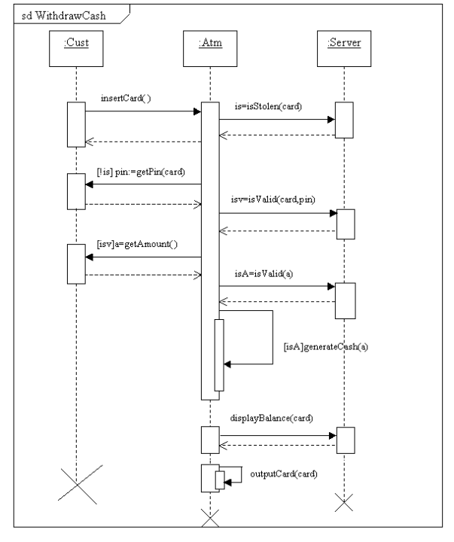

Slide 5
Notation for sequence diagrams
  Consider the sequence diagram for the "all goes well" scenario of the "Withdraw Cash" use case.
  3 objects of the classes ATM, Server and Customer.
  Shown by using a rectangle. In the rectangle, a colon followed by the name of the class with the entire text underlined indicates the object. The object may or may not be named.
  The dashed vertical line is the object's lifeline.
  Activation boxes are the numerous rectangular boxes interrupting the lifeline.
  They indicate that the object is either executing its own code or waiting for the return of another object to which it had sent a message.
  Use of activation boxes is optional. If they are omitted, it becomes easier to draw the diagram but difficult to comprehend it.

Slide 6
Notation for sequence diagrams
  The object of the Customer class sends a message to the object of the Atm class asking it to execute its onInsertCard( ) operation.
  The object of the class ATM sends a message to the object of the class server asking it to execute its operation isStolen() with actual parameter “card”.
  The reply from the server is assigned to isStolen variable.
  The message is shown on the top of an arrow from the sender object to the receiver object.
  The return from the message is indicated by a dashed arrow.
  Unnecessary to show the return for every message because it will clutter the sequence diagram.

Slide 7
Notation for sequence diagrams
  Any condition is put in a bracket.
  If the condition "is" is assigned the value "false" then the message getPin(card) will be sent.
  Self-Call-An object can send a message to itself.
  If the amount entered by the customer is valid, then the object of the class Atm sends a message to itself asking itself to execute its own operation generateCash( ).
  Deletion of an object is shown by a large ‘X’ at the end of the lifeline.

Slide 8
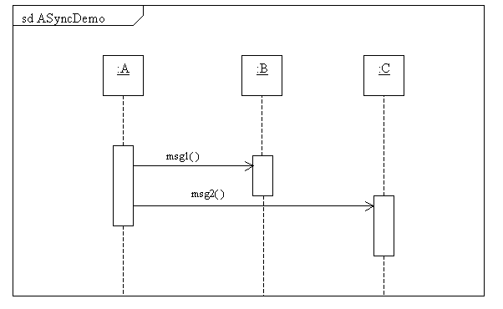
Depiction of Asynchronous messages

Slide 9
Depiction of Asynchronous messages
  Suppose an object of class 'A' sends a message msg1( )to object of class 'B'.
  If the first object does not have to wait for the return then the message is asynchronous. i.e. the object of class "A" can continue to do its own processing like sending a message msg2( ) to object of class "C".
  It does not have to wait for the object of class "B" to finish executing its operation.
  The asynchronous message is shown on the top of an arrow with unfilled arrowheads.

Slide 10
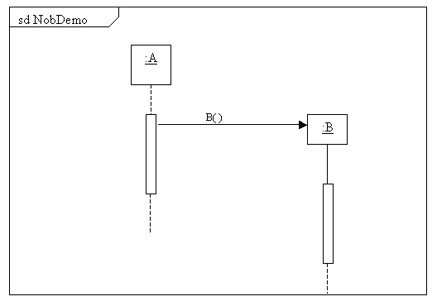
Creation of new objects

Slide 11
Creation of new objects
  Consider the case of an object of class A creating an object of the class B.
  It is depicted by showing an arrow from an activation box over the lifeline of the object of the class "A" to the created object of class "B“.

Slide 12
Combination Fragments
  Sequence Diagrams can be broken up into chunks called fragments.
  Around each fragment a frame is drawn.
  There is a specifier in the upper left-hand corner of the frame that represents an operator that states how the fragment is handled.
  There are one or more than one operand regions within the fragment.
  They are placed vertically and each is separated by a horizontal dashed line.

Slide 13
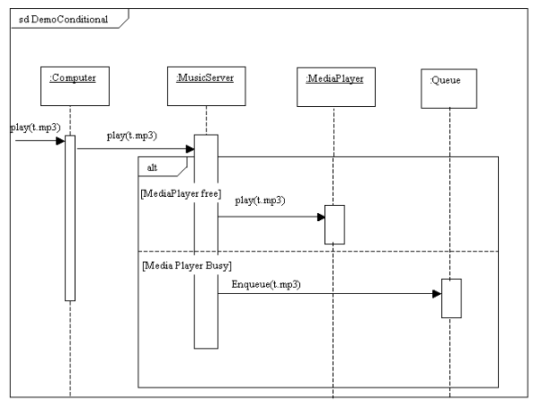
The alt combination fragment

Slide 14
The alt combination fragment
  The specifier is titled "alt" for conditional behaviour.
  Either one out of the two operand regions will be invoked.
  If the Media Player is free then a message is sent by the MusicServer object to the MediaPlayer object to invoke its "play" method with actual parameter "track1.mp3".
  If the Media Player is busy a message is sent to the Queue object to execute its Enqueue( ) operation.
  If there are multiple conditions and if it is necessary to execute a sequence of instruction if all the conditions fail, then an "else" can be included.

Slide 15
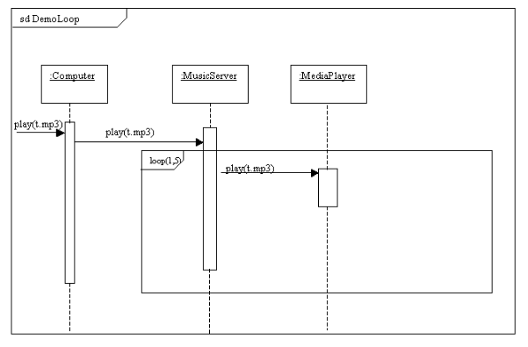
The loop combination fragment

Slide 16
The loop combination fragment
  Suppose it is necessary for the Media Player to play the track "t.mp3" 5 times.
  The keyword "loop" with parameters 1,5 is included in the pentagram of the fragment.
  So play(track1.mp3) operation will be invoked 5 times.

Slide 17
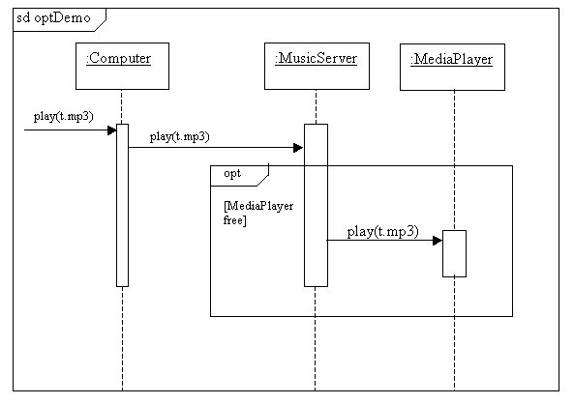
The opt Combination fragment

Slide 18
The opt Combination fragment
  It is used to model a "if-then" statement.
  If a certain condition occurs then the execution of the messages take place.
  This combination fragment is similar to the “alt” combination fragment with the exception that there is no else part to it.
  The keyword "opt" is used in the pentagram at the top left-hand corner of the frame.
  E.g. The Computer sends a message play(t.mp3)to theMusicServer. If the MediaPlayer is free, the MusicServer sends the play() message to it.

Slide 19
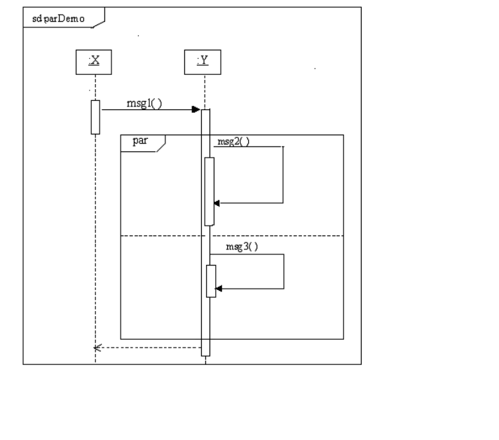

Slide 20
The par Combination fragment
  It depicts the concurrent execution of operations.
  The word “par” is included at the top left-and corner of the enclosing frame within a pentagram.
  A message msg1( ) is sent to object of the class Y by the object of class X.
  Upon receipt of this message, it sends two messages msg2( ) and msg3( ) to itself at the same time.
  Upon execution of these messages control is transferred back to the object of class X.

Slide 21
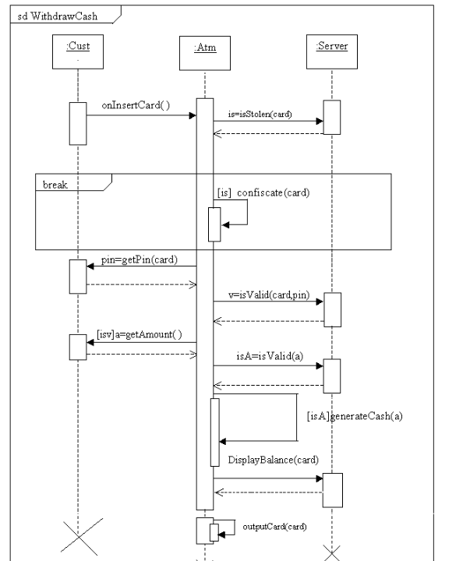

Slide 22
The break combination fragment
  The frame has the keyword “break” in the pentagram.
  It indicates that when a break is encountered all statements within the frame are executed but the remainder of statements out side the frame are skipped.
  There is a provision of using the break fragment if the card is stolen.
  The object of class Atm will send a confiscateCard message to itself.
  If the Customer indeed inserts a stolen card, then only the sequence of messages within the break fragment will get executed (in this case the operation confiscate( ))and the remainder of the immediately enclosing outer frame will be skipped.

Slide 23
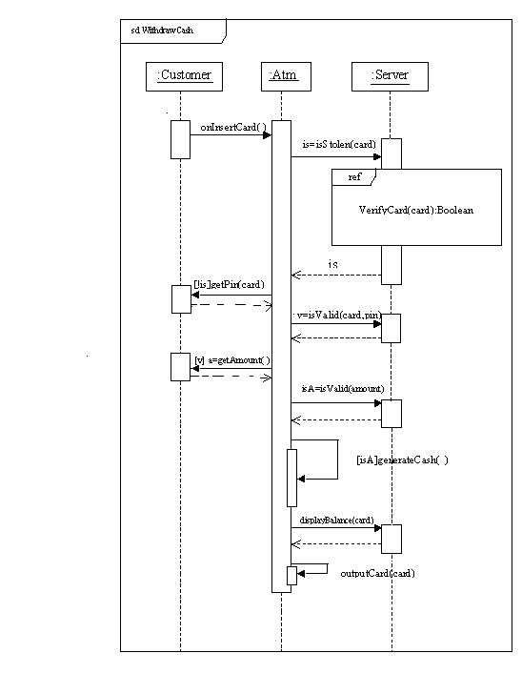

Slide 24
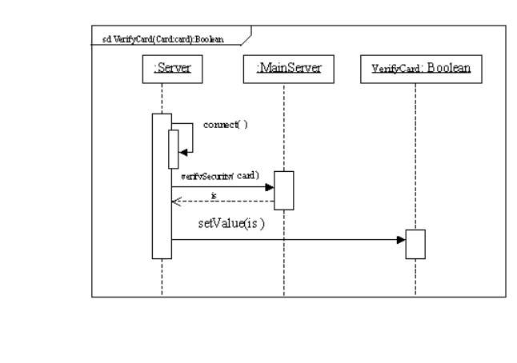

Slide 25
The ref combination fragment
  Sequence diagram Withdraw cash references the sequence diagram VerifyCard.
  The sequence begins at the top left hand corner of the outer enclosing frame.
  The object of the class Customer sends a onInsertCard( ) message to the object of the class Atm.
  Upon receipt of this message, the object of the class Customer sends a isStolen message to the object of the class Server with the card as the parameter.
  At this point the VerifyCard sequence diagram is called with the card passed as the parameter.

Slide 26
The ref combination fragment
  The VerifyCard sequence diagram returns a variable of the type boolean. i.e. Either the card is stolen or it is not.
  The lifeline of the object of the Server class is hidden by the interaction occurrence "VerifyCard".
  This means that the lifeline of the object of the Server class is referenced in the "VerifyCard" sequence diagram.

Slide 27
The ref combination fragment
  The sequence diagram "VerifyCard“ takes in an argument of the type Card and returns a boolean variable.
  This is indicated in the pentagram on the top left-hand corner of the enclosing frame.
  Boolean variable being returned is given the instance name of the sequence diagram.

Slide 28
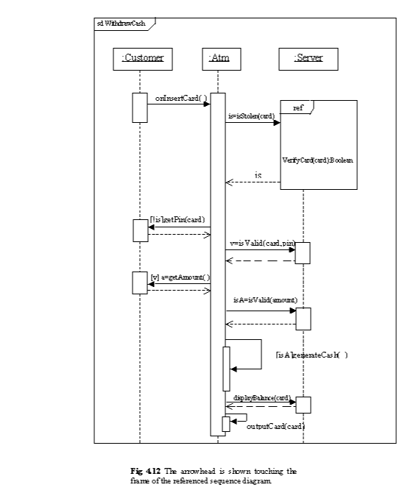

Slide 29
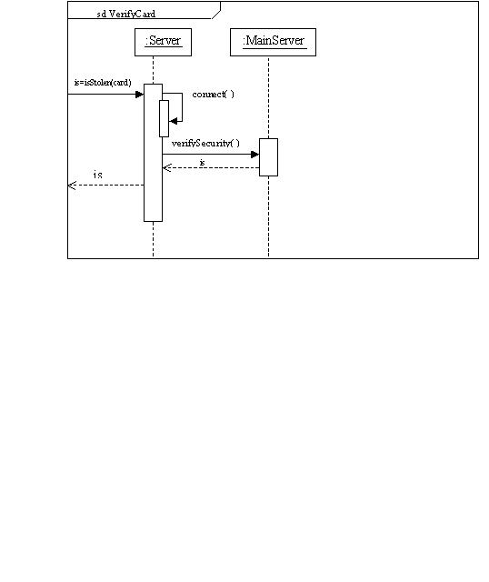

Slide 30
Gates
  The referencing of a sequence diagram by another can be alternately depicted by using gates.
  A gate is a message on an arrow whose one end is connected to the lifeline and the other to the frame's edge of a sequence diagram.
  Two types of gates entry and exit gate.
  The entry gate has the head of the arrow connected to a lifeline and the tail connected to the frame edge.

Slide 31
Gates
  The exit gate has the head of the dashed arrow connected to the frame edge and the tail to the lifeline.
  The entry gate is a message on the arrow (whose head is connected to the lifeline of the object of the Server class) called isStolen that takes a parameter of the type card and returns a Boolean variable which is assigned to "is".
  The exit gate is shown at the end as a dashed arrow with the head connected to the frame and the tail connected to the lifeline of the Server object.

Slide 32
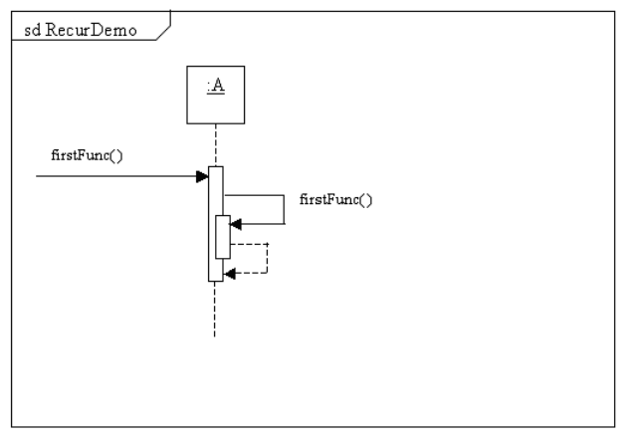
Recursion

Slide 33
Recursion
  A recursive operation is one that will continue invoking itself till some terminating condition is met.
  While representing recursive operations in a sequence diagram, the message must always be synchronous.
  The FirstFunc() operation will call itself till some terminating condition (which must be compulsorily present) is met.

Slide 34
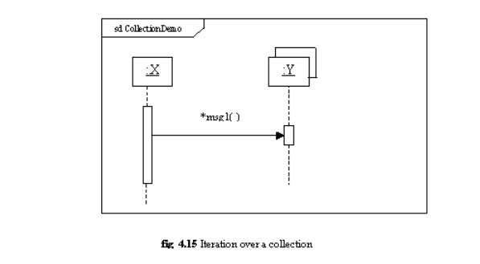
Iteration over a collection

Slide 35
Iteration over a collection
  There is a multiobject of the class Y.
  An object of class X sends a message msg1( ) to Y.
  An asterisk is placed preceding the message name and the multiobject is indicated as shown.

Slide 36
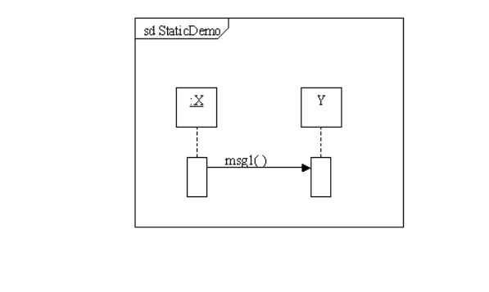
Invoking static messages

Slide 37
Invoking static messages
  An object of class X sends a message to class Y asking it to execute the static operation msg1( ).
  The message being sent to a class Y and not to an object is indicated by not underlining Y.

Slide 38
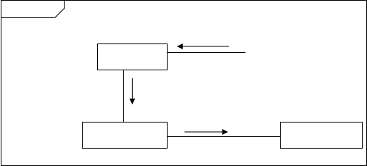
Communication Diagrams
sd Music
play(t.mp3)
:Computer
1:play(t.mp3)
1.1 play(t.mp3)
:MusicServer
:MediaPlayer

Slide 39
Communication Diagrams
  Second form of Interaction Diagram.
  The sequence of messages is indicated by explicitly numbering them
  There are 3 objects of the classes Computer, MusicServer and MediaPlayer.
  The actor initiates the use case by asking the object of the type Computer to execute its play() operation.
  The object of the type Computer sends a message to the object of the type MusicServer asking it to execute its play() operation.
  This message is given the number 1.

Slide 40
Communication Diagrams
  The receipt of this message prompts the object of the type MusicServer to send a message to the object of the type MediaPlayer to execute its play() operation.
  Message 1.1is a nested message. After message 1.1 has been executed, if the object of class Computer had sent a message to some other object, it would have been numbered as 2.
  If, after message 1.1 has been executed, the MusicServer had sent another message to object of class MediaPlayer or to any other object it would have been numbered as 1.2.
  If the object of class MediaPlayer sent a message to any object after the receipt of massage numbered 1.1, that particular message would have been numbered as 1.1.1.

Slide 41
Labeling Messages
  Formal syntax:
  [predecessor] [guard condition] sequence expression [return value ':='] message-name '(' [argument list] ')'
1) Characters in single quotes like := and () are literal values.
2) Terms in [] are not compulsory.
3) Other terms are replaced by actual values.
4) Terms in braces {} are repeated zero or more times.

Slide 42
Labeling Messages
  Predecessor- It is a list of the sequence number of messages that must occur before the current message is sent.
  This feature is useful if branches are present.
  If no branch is present then Predecessor can be safely omitted.
  Syntax of the predecessor:
sequencenumber1 {',' sequencenumber2}'/'
  The forward slash indicates the end of the list. It is indicated when an explicit predecessor is shown.

Slide 43
Labeling Messages
  E.g. 1,1.1,1.2,2,2.1 /3:msg1()
  It means that for msg1() to be passed messages with sequence numbers 1 (with nested messages 1.1 & 1.2) and 2 (with nested message 2.1) must have been passed.
  Guard Condition- It must be true before the message can be passed.
  It is stated in any programming language or psuedocode.
  No UML specification to state it.
  E.g. [MediaPlayer free] 1.1. play()
  The message play() will be sent only if the MediaPlayer is free.

Slide 44
Labeling Messages
  Sequence Expression- It is a list of integers optionally separated by dots followed by a single letter name followed by a recurrence term and terminated by a colon.
  integer {'.' integer} [name] [recurrence]':'
E.g. 1.1a *[i=1..10]:play()
  The above example indicates that the message to execute play() is labeled 1.1a and it will iterate 10 times.

Slide 45
Labeling Messages
  Return Value
E.g. 1.1a [i<10]:y=play()
  If i<10 only then play() will be executed and the output of play() will be assigned to y.

Slide 46
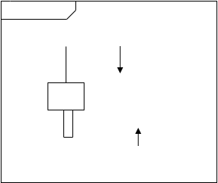
Messages to self
sd SelfDemo
msg1( )
:A
1:msg2( )

Slide 47
Messages to self
  Suppose the receipt of the message msg1() causes the object of the type A to send a message msg2() to itself.
  This is indicated by drawing a link from the object to itself.

Slide 48
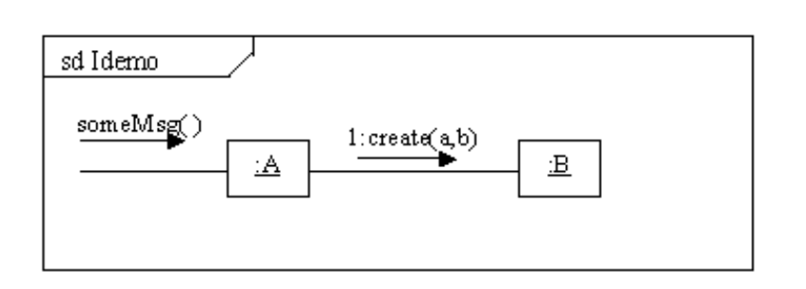
Depiction of Instance Creation (first way)

Slide 49
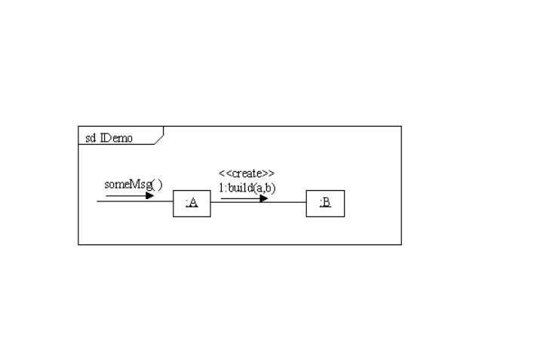
Depiction of Instance Creation (Alternate way)

Slide 50
Creating instances
  In the UML, the convention to create an object is to name the function creating it as "create".
  But if any other name is used, then the message can be adorned with the <<create>> stereotype.
  E.g. Suppose an object of the type A creates an instance of the class B by using the create message and passing 2 parameters a and b.

Slide 51
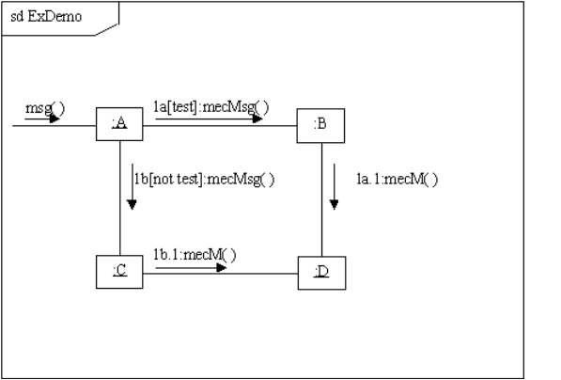
Mutually Exclusive Conditional Messages

Slide 52
Mutually Exclusive Conditional Messages
  On receipt of the message msg(), the object of the class A sends a message named mecmsg() to the object of the type B only if the condition test is true.
  Else it sends a message mecmsg() to the object of the class C.
  The mutually exclusive messages are numbered 1a and 1b respectively.

Slide 53
Mutually Exclusive Conditional Messages
  Suppose test was true and the object of the class B had received the message mecmsg().
  As part of the execution of mecmsg(), it sends a message mecm() to the object of the class D. This nested message is labeled as 1a.1
  Suppose test was false and the object of the class C had received the message mecmsg(). As part of the execution of mecmsg(), it sends a message mecm() to the object of the class D. This nested message is labeled as 1b.1

Slide 54
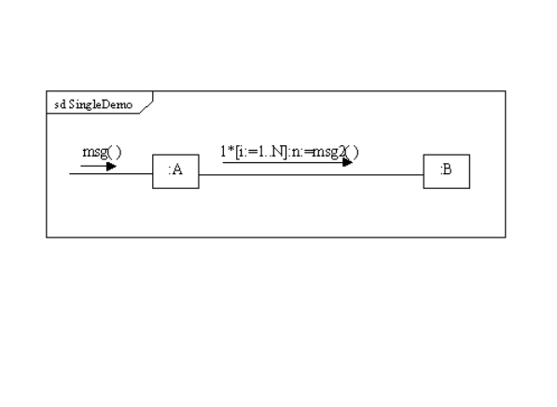
Iteration for a Single message

Slide 55
Iteration for a Single message
  On receipt of message msg(), the object of class A sends a message msg2() to the object of class B 'N' times.
  Indicated by putting an asterisk after the message number.
  Suppose the modeler does not want to show the number of times the message is sent, then he can omit the brackets and the entire text within them.

Slide 56
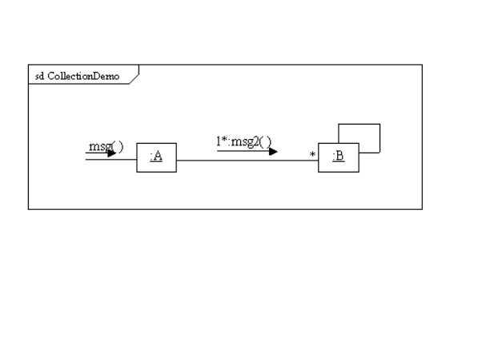
Iteration over a Collection

Slide 57
Iteration over a Collection
  Suppose there is a collection of objects called B.
  On receipt of message msg() the object of the class A sends a message msg2() to every object in the collection.
  It is indicated by showing an asterisk after the message number as well as at the end of the link on the collection side.
  Double-box indicates the multi-object .

Slide 58
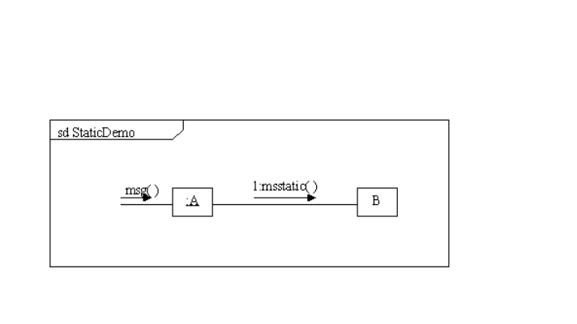
Invoking static messages
  Suppose an object of the class A wants to invoke the static message msstatic() of class B.

